Slide 1

Customer Churn
Group 6
Lu Han
Yuqing Li
Jorge Payne
Chakradhar Rajineni
Disha Sugandhi

Slide 2
Contents
Business Problem
Data Description
SEMMA
Model Comparison
Business Insights
Conclusion and Recommendation

Slide 3
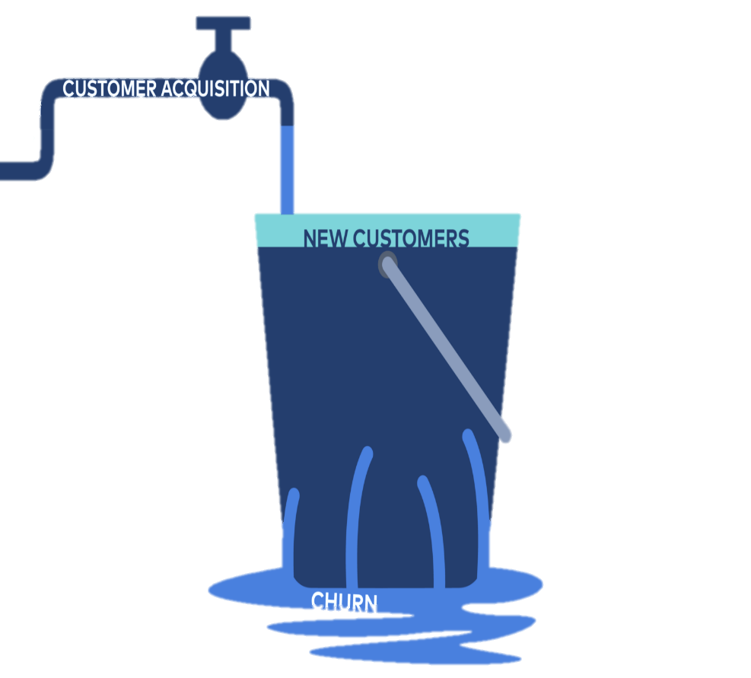
Business Problem
As a telecommunication company, we aim to provide the latest technology and highest reliability to our subscribers at an affordable price. This strategy relies on attracting and retaining customers by reducing customer "churn".
This project identifies subscribers susceptible to "churn" and offers solutions to maintain their subscription to our services.
Notes:
As a telecommunication company, we aim to provide the latest technology and the highest reliability to our customers at the most affordable price. Part of this strategy relies on attracting and retaining customers by reducing what is called customer "churn".
Churn is an undesirable phenomenon where subscribers leave in search of better value. This requires additional marketing expense to attract more customers to make up for loss in revenue. That in turn can have a spiraling effect, as intensified marketing costs across a smaller subscriber base results in even higher costs, resulting in even more churn.
This project looks to identify those subscribers most susceptible to "churn" so that we may anticipate churn before it happens and direct our attention to those customers. By reducing churn, we maintain a steadier customer base that enables us to improve our revenue stream and reduce our marketing costs with minimal investment, thereby allowing us to make our product even more desirable - both to our customers and shareholders. Success in this effort will breed more success as a better product will further reduce the likelihood of churn.

Slide 4

Business Problem
Find a pattern among the demographics, services, plans, and customer information to determine their correlation to churn.
Develop a model to predict which customers are more likely to leave.
Identify where we can make effort to overcome churn.
Notes:
We need to analyze all attributes that characterize each customer of the telecom company to find a pattern between the demographics, requested services, plans, customer account information and their relation to churn to see why customers stay or leave.
In addition, for making the pattern useful in our future actions in retaining customers, we will develop a model that help to predict which customers are more likely to leave. And identify the critical factors on which we should make efforts.

Slide 5
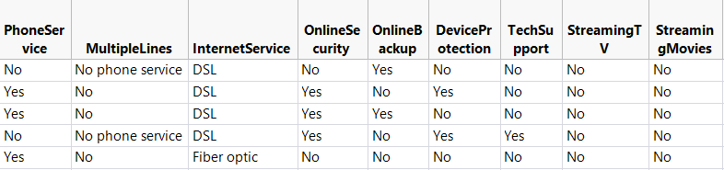
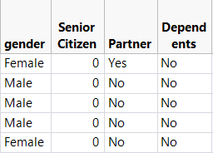
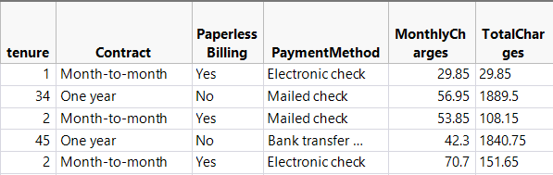
Data Description
The dataset contains records of 7,043 observations in 21 columns. Column 21, titled Churn, is our target variable that indicates customers who left in the last month, having a value of “Yes”; otherwise Churn is “No”. We group predictors (excluding customer ID) into 3 categories as below.
• Services signed up for
• Demographic information
• Customer account information

Slide 6
Analysis Plan
Principle: SEMMA
Use classification concepts
Decide model by model comparison
Sample
Explore
Modify
Model
Assess
Logistic Regression
Partition Decision Tree
Bootstrap Forest
Boosted Tree
Neural Network
K-Nearest Neighbor
Naïve Bayesian
Eliminate all the missing values
Find relationships among all the variables
Notes:
A prediction like customer churn, with 19 variables takes a big chunk of data for Training. SO we have sampled our data like 50:30:20 for Training, validation and Testing.
As we sampled the data, we wanted to look into all attributes or groups they fall into. We have explored that demography is reflecting the actual society with 50-50 gender ratio, 30% of senior citizens. The basic services that customers must opt are phone service or internet service with internet service providing 2 options of DSL or fibre optic with other services as Add-on’s.
Our customer data has 55% people opting for month-month service while 2 year is opted by 24% and 1 year by 21%.
The most correlated to churn is Total charges with positive correlation.
We have 11 missing values in Total charges, which are imputed with Average values with consideration of monthly charges.
Since our output is categorical, we have started with logistic regression, then decision tree and did all options available in JMP.
My team mate Jorge will explain about the results of these models and take it forward.

Slide 7
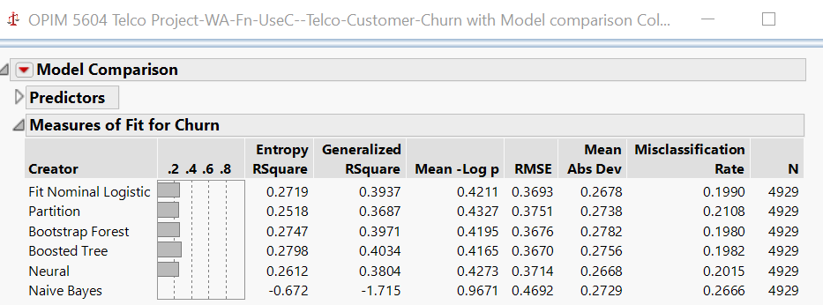
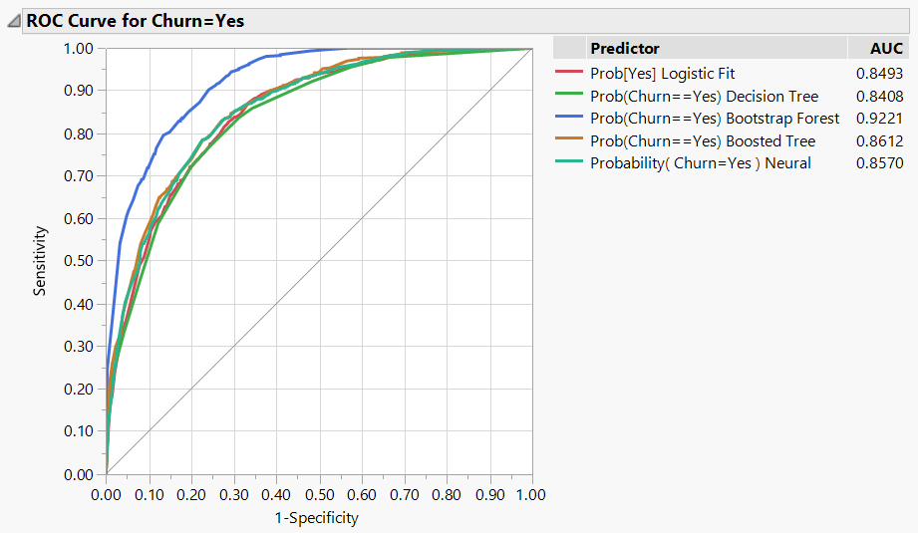
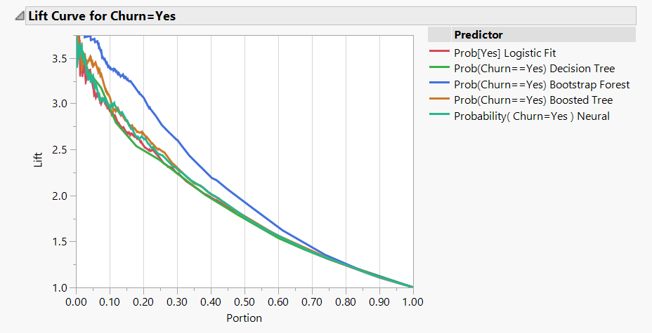
Model Comparison
Bootstrap Forest model provides the best prediction capability
Notes:
After trying all available models, we selected six outstanding models to do model comparison, the formula metrics all indicate that
Bootstrap Forest has the lowest misclassification rate, highest AUC, highest lift, high level of R², low level of RMSE

Slide 8
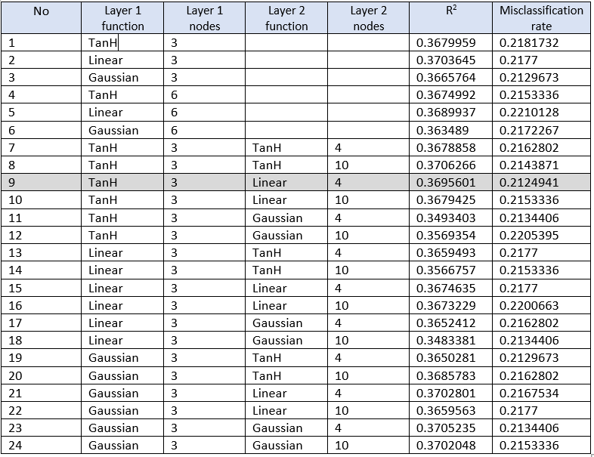
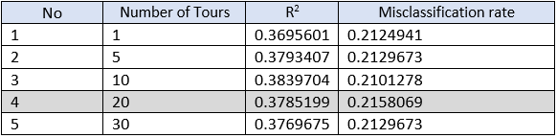
Model Comparison
Neural Network has slightly better performance than Bootstrap Forest, but its overall complexity makes it
less parsimonious.
Notes:
Most of the time, Neural Network could have a better prediction. Then we used these predictors as inputs in Neural Network again, trying combinations of layers, nodes, and activations to check the performance.
From the results left, we can see that (TanH 3 nodes, Linear 4 nodes) has the best performance, then we tried to re-fit the model multiple times by setting Number of Tours with different numbers.
After all the trying efforts, we found that the performance are all worse than Bootstrap Forest model.

Slide 9
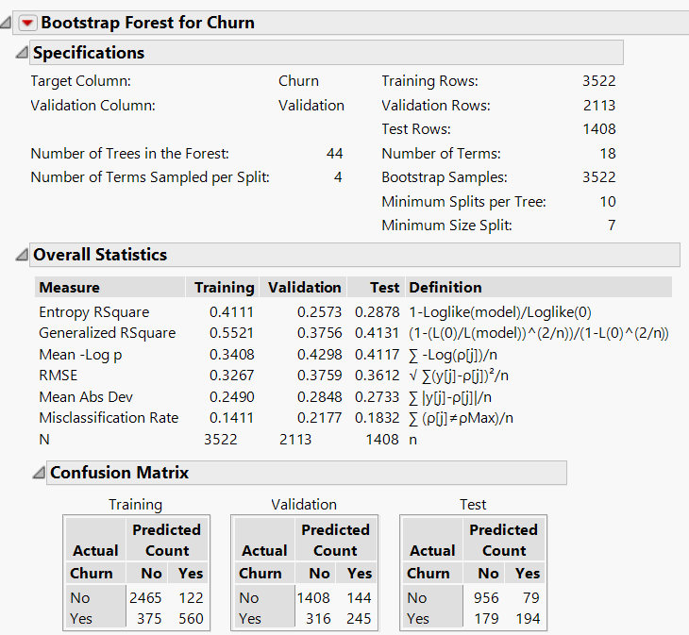
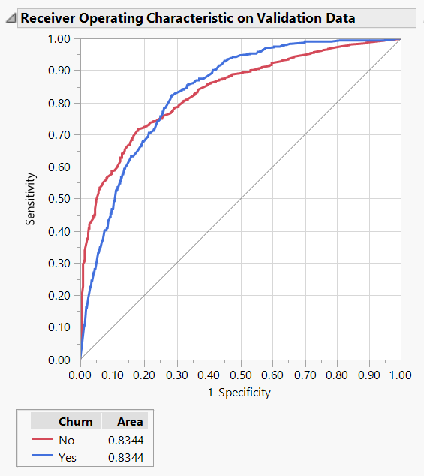
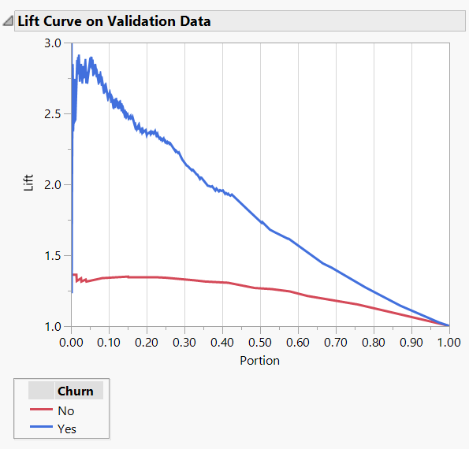
Model Selected
Bootstrap Forest
Notes:
Bootstrap Forest model created 44 trees for its forest.
Although the generalized R2 for validation data set is only 0.3756, the Misclassification Rate is 0.2177, Accurate Rate is 0.7823.
Bootstrap Forest has an AOC area as 0.8344.
For the first 10% of the customers that are ranked by the model as most probable left customers yields roughly 2.6 times as many left customers as would simply selecting 10% of customers random.

Slide 10
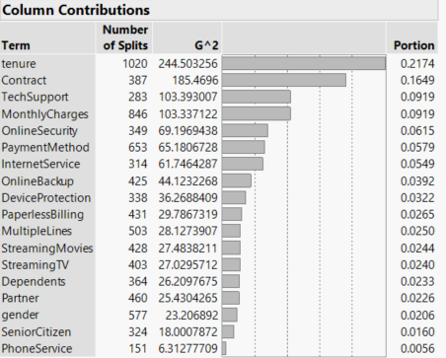
Important Contributing Factors
Important Factors:
Tenure
Contract
Monthly Charges
TechSupport
OnlineSecurity
PaymentMethod
InternetService
Notes:
From the Column Contributions of Bootstrap Forest model, we can know that Tenure, Contract, TechSupport, MonthlyCharges, OnlineSecurity, PaymentMethod, and InternetService are important factors (portion above 5%) that would contribute the most to the classification process.
In next step, we would exam all the important variables separately to get business insights from them.

Slide 11

Business Insights

Slide 12
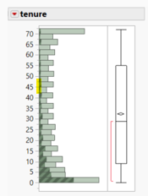
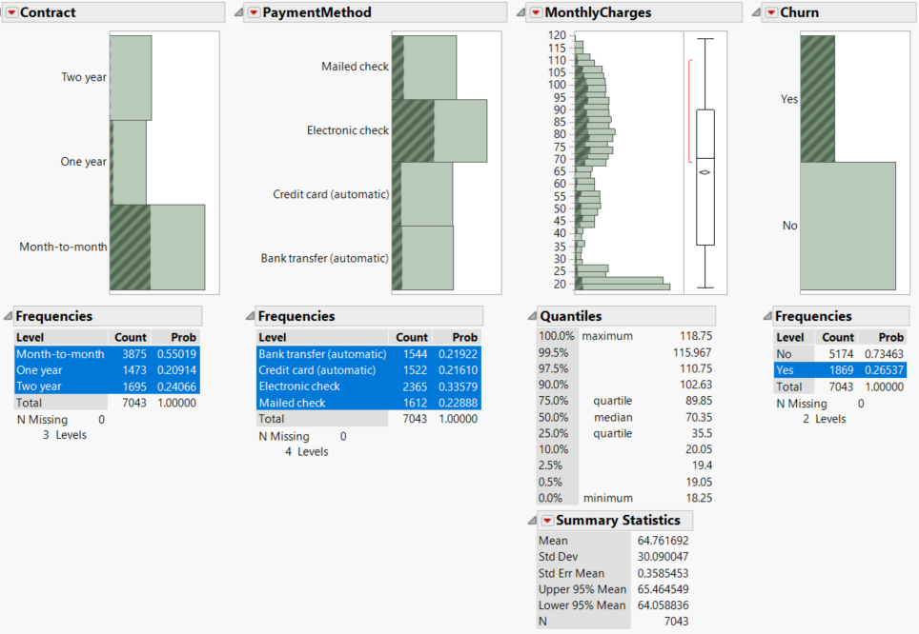
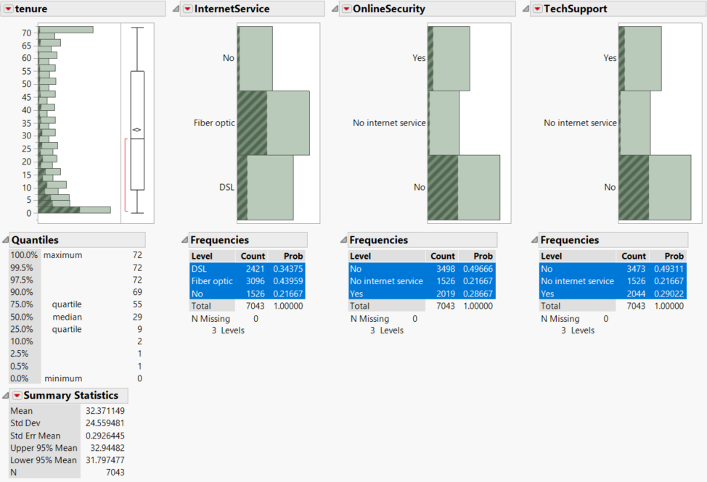
Examination of Important Factors
Notes:
Except that the Bootstrap Forest model we got to predict whether a future customer will leave, we can also got some general concepts about how these predictors would affect customer attrition--i.e., Fiber optic InternetService, No online Security, No techSupport, and Month-to-Month PaymentMethod are all characteristics that may result in customer attrition.

Slide 13
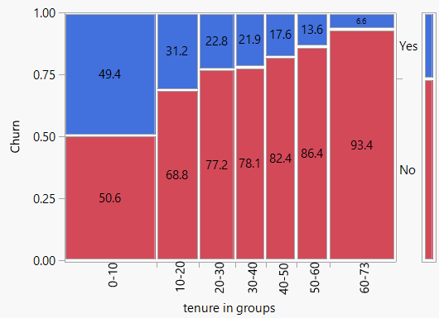
Insights about Tenure
We need to pay more attention to new customers, those with tenure ranging from 0 to 10 months
Ensure customers appreciate the company’s competitive advantages;
Extend customers’ commitment;
Adopt more active marketing strategy
Notes:
As the tenure grows, the churn rate would decrease. But when the tenure is between 0 and 10 months, the churn rate is almost half of the total customers, which means we need to pay more attention to customers with 0 to 10 months.
We should try to transfer customer loyalty to brand loyalty, the efforts may include:
1) Showing customers the day-to-day value of using the company’s product, by providing ample and versatile content about the key functional benefits of the telco product.
2) Extending the customers’ commitment, by providing discount for a long contract, say 2-3 years, making customers have enough time to explore the advantages of the product.
3) Adopting a more active propaganda strategy, making customers know the company’s competitive advantages and believe that their service is the most popular and advanced one, to lower the probability that they would be attracted by other competitors.

Slide 14
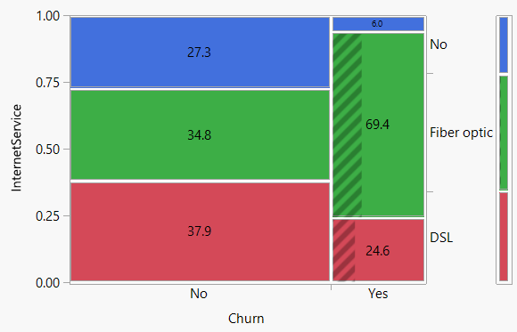
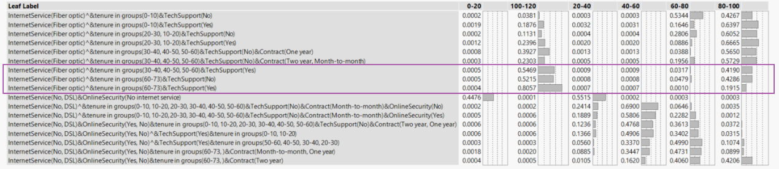
Insights about Internet Service
When taking consideration about Internet Service, we can focus on those customers choosing fiber optic.
Adopt a service diversity strategy
Design high-end service for customers highlighted above
Notes:
Generally speaking, fiber optic provides a faster speed asking for higher price than the common DSL service. And of course, the customers choosing this option might be the most valuable customers who would bring in the biggest revenue. The reasons for their leaving might be the less satisfied with the service they got.
Adopting a service diversity strategy—i.e., tailoring product options and providing personalized service offer. And of course, the strategy should base on profiling and identifying customers with various demand of service.
So, we made a further analysis on how the critical factors would affect high total charges. The results are as below.
(PICTURE)
We can find that Customers who chose Fiber optic, with tenure 30-73, need tech support are more likely to pay more money for better service. So, it would be reasonable to design high-end service for these customers.

Slide 15
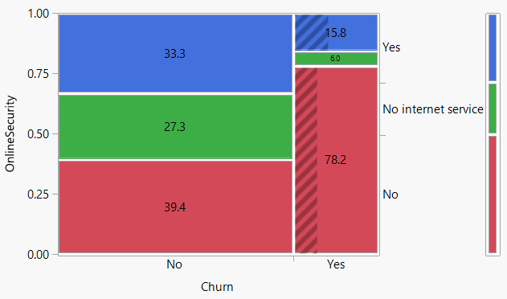
Insights about Online Security
We should focus on customers who do not buy Online Security service.
A. Change customers’ surfing habits
1) Better targeted marketing
2) Design bundled service plan
B. Provide adequate educational or support materials on types of online fraud and how we can help protect our customers
Notes:
Most of time, online security is kind of surfing habit, which would also ask for extra money.
1) Changing customers’ surfing habits, by using more propaganda or designing bundling service plan including both security service and telco service. The new plan could increase customer stickiness, in other words—not leave, since the bundling service would hinder customers from changing service easily.
2) Providing enough educational or support materials, offering free trainings, webinars, video tutorials, and product demos—whatever it takes to make customers feel comfortable and informed on their telco and internet service.

Slide 16
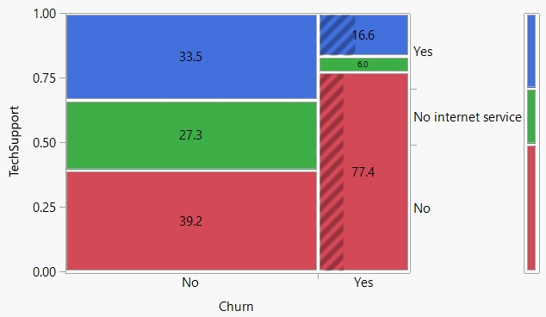
Insights about Tech Support
Focus on customers who do not routinely use Tech Support service.
Provide comprehensive and detailed support directions for customers
Enhance customer service support; improve wait time?
Notes:
People does not need tech support might have several reasons, such as customers do not encounter any tech problems, they did not find ways to connect with tech staff, or they do not like the support service. By comparing with the ratio among using support, not using support, and no internet service, which shows a more even distribution, we can speculate that it is more possible that customers have bad user experience with no tech support when they have problems with the service. Rational method may include:
1) Making comprehensive and detailed support direction for customers, introducing tech support guide to customers who had never called for tech help.
2) Enhancing customer service, by assigning tech experts in the customer service support department and designing a more efficient response mechanism.

Slide 17
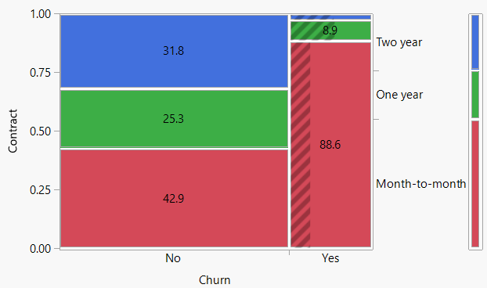
Insights about Contract
For Contract options, customers who pay on a month-to-month basis are more likely to leave.
Offer promotions for longer contact period
Notes:
The customers who sign long contract have lower churn rate. The customers with month-to-month contract has the highest rate to churn. We can provide more promotions for longer contact period to attract and retain more customers.

Slide 18
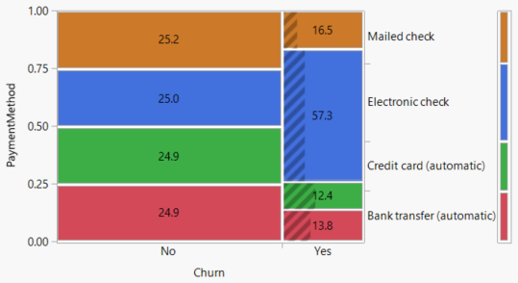
Insights about Payment Method
Customers who pay by electronic check are more likely to leave.
Offer options for automatic payment methods
Notes:
The customers who pay with electronic check have the highest churn rate. The customers who pay with credit card automatically has the lowest churn rate. We can provide more promotion with automatic payment method to attract and keep more customers.

Slide 19
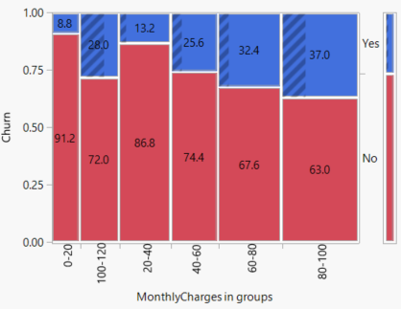
Insights about Monthly Charges
Customers who pay more than 40 dollars per month are more likely to leave.
Providing higher quality services with higher monthly fee or bundle services to offer higher value for same payment
Notes:
The customers who pay more in monthly total are more likely to churn especially over 40 dollars per month. The monthly payment between 80 and 100 has the highest churn rate. So we need to pay more attention to the customers who has monthly charges over $40. We can provide higher quality services with higher monthly fee to keep more customers.

Slide 20
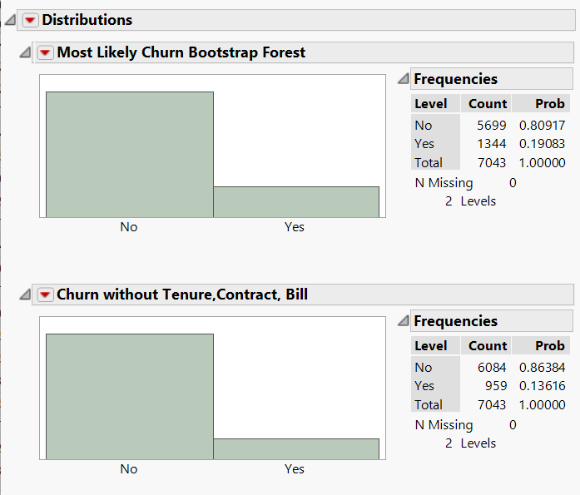
Conclusion and Recommendation
Our model concludes that by addressing the three largest factors contributing to churn, Tenure of Contract, Monthly Bill, and Contract Type, churn can be reduced from the current 19% down to 13%, representing a retention of 385 customers per month who would otherwise leave.
An incentive offering credit on monthly bill using autopay for an extended contract period of 1 or 2 years simultaneously addresses the above three factors
This immediate gain would enable future improvements, including improving bandwidth and tech support, which, in turn, would further reduce churn.
Notes:
After going through several steps to process the data. we identified some important churn predictor variables from models and compare these models.

